Slide 1




HOPE TO SKILL
Lecture 28
Convolutional
Neural Network(CNN)
Artificial Intelligence Advance Course

Slide 2


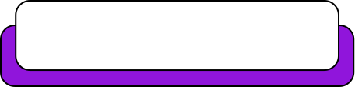
Dedicated to my late Teacher, a beacon of Knowledge.
Your Guidance shaped me; now I shape others through
a free course.
YOUR LEGACY LIVES ON!

Slide 3




AI INSTRUCTORS
Dr.Irfan Malik
Dr.Sheraz Naseer
Dr.Shazia Saqib
M.Haris Tariq

Slide 4



Previous Lecture Topics
01
Limitations of Simple Neural Network
02
Introduction to CNN
03
Images and Features
04
Kernel, Convolution

Slide 5
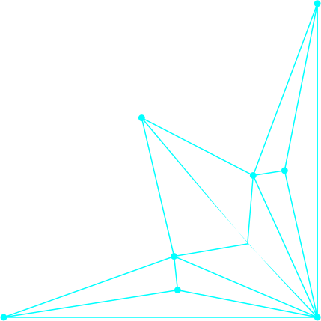
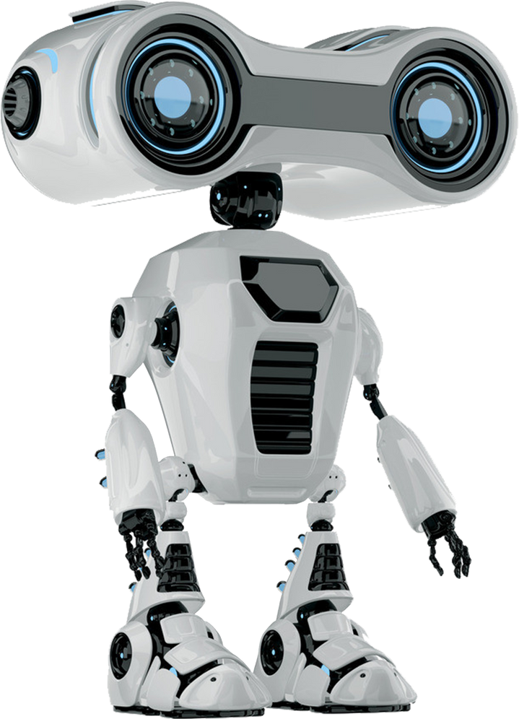

Outline
Convolutional Neural Networks (CNN)
Architecture of CNN
Convolution
Filter
Pooling
Stride
Padding
Number of filters/Depth
Receptive Field

Slide 6

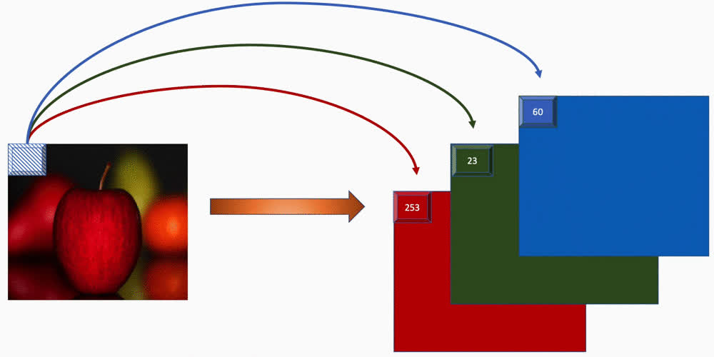
Images in Computers
Understanding image channels (RGB)

Slide 7
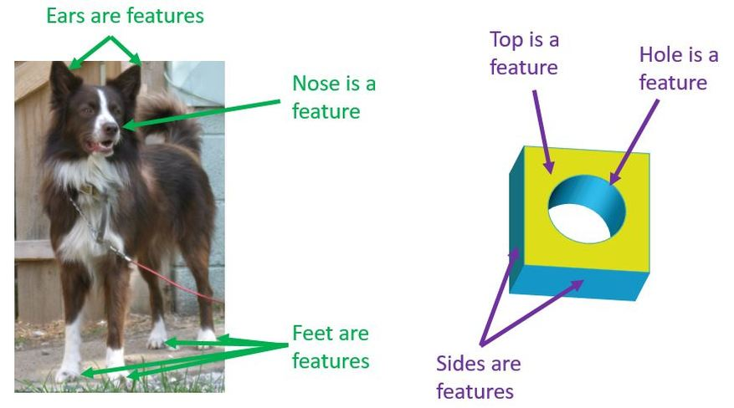
Features for Images
Images are full of important parts called features.
Features can be edges, textures, shapes, or even faces.

Slide 8

How CNN Work on Image

Slide 9
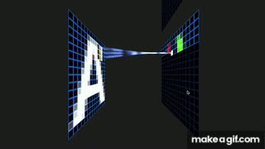
Convolution
Convolution is like a special way of looking at data. It's a mathematical operation that brings out patterns.

Slide 10
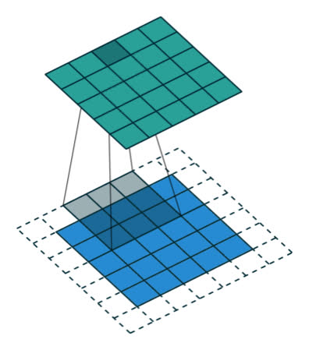
Convolution
Applies filters to the input image to
create feature maps.
Filters are small matrices that slide
over the input image and detect patterns.

Slide 11
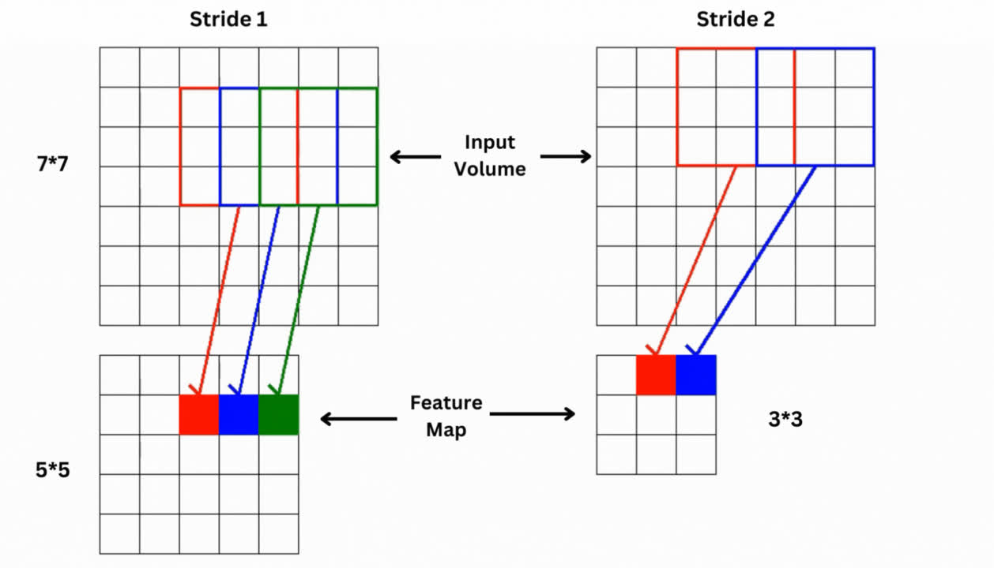
Stride
Stride in CNN determines the step size of the filter as it moves across the input data during the convolution operation, affecting output size and computational efficiency.

Slide 12
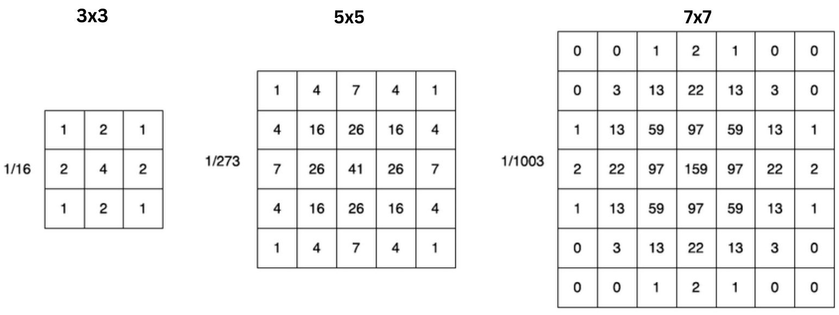
Kernel/Filter
Kernels in CNNs are usually small 2D matrices used for feature extraction through convolution operations on input data, typically with dimensions in odd numbers.

Slide 13
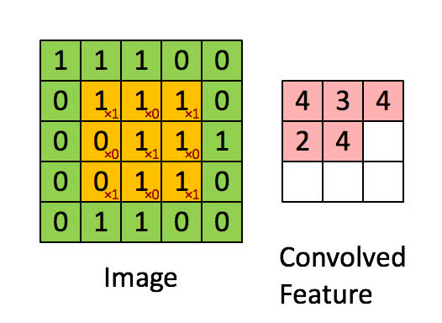
Convolution Operation
At each position, the kernel performs el﻿ement-wise multiplication with the corresponding part of the input data it covers.
Then, the results of these multiplications are summed up to produce a single output pixel.

Slide 14
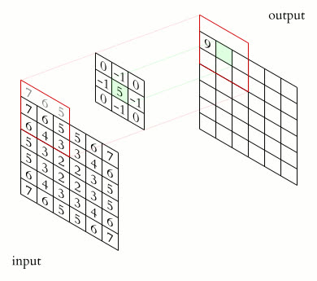
How Kernels Work
Convolution on an (h, w, in_dims) image gives an (h', w', out_dims) feature map.

Slide 15
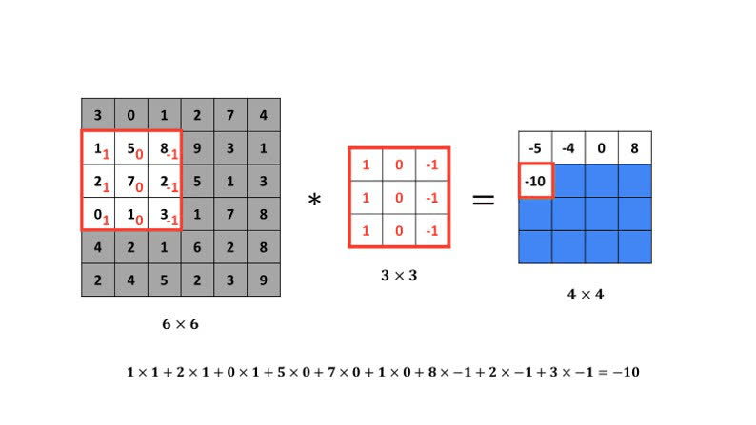
Vertical Edge Detection

Slide 16
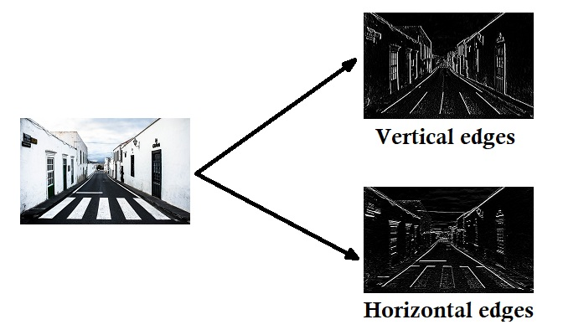
Edge Detection

Slide 17
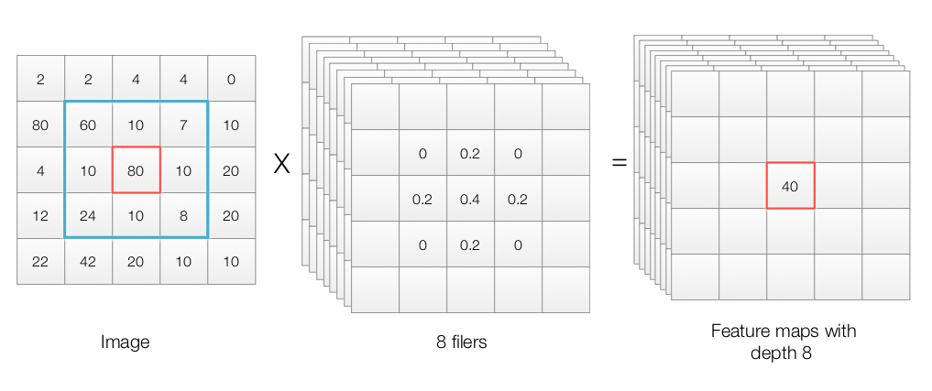
Depth
In CNNs, each layer consists of multiple filters (kernels), each producing a separate feature map. The number of filters in a layer determines its depth.

Slide 18
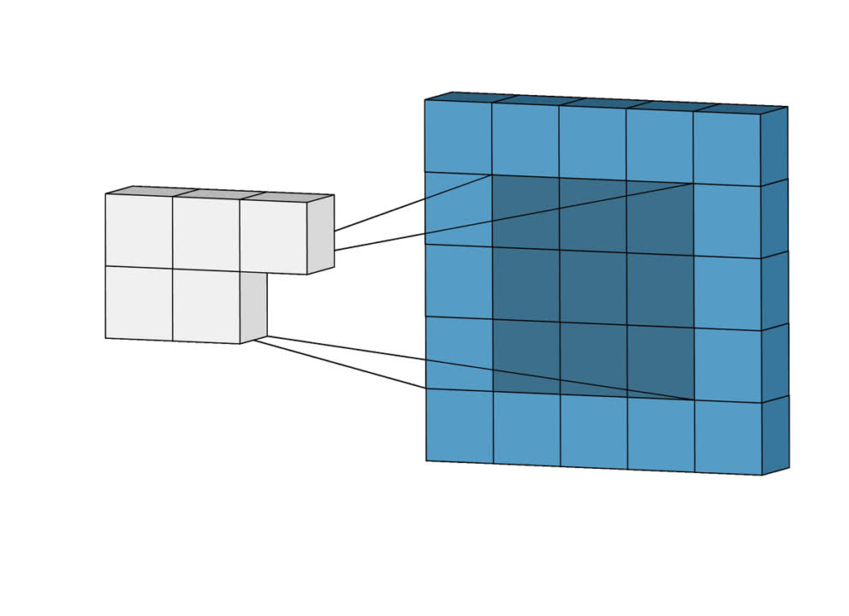
Padding
Padding is a technique used to maintain the
spatial dimensions of the input image after
performing convolution operations
on a feature map.
In plain English, a padding is “a
piece of material used to protect
something or give it shape.”

Slide 19
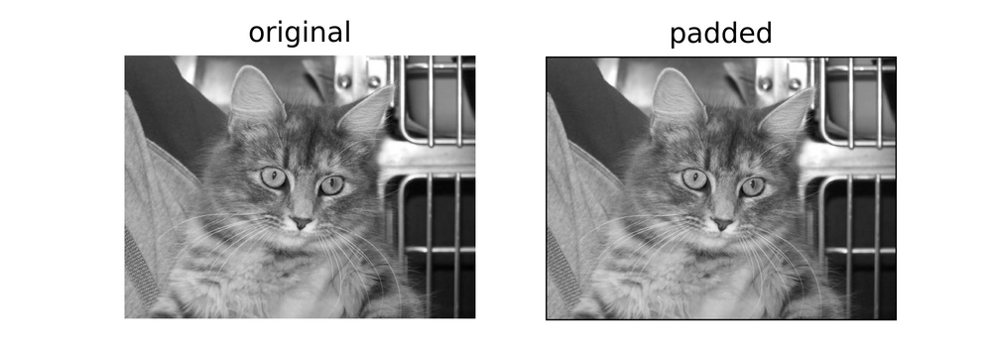
Padding

Slide 20
Types of Same Padding
Zero Padding
Ones Padding

Slide 21
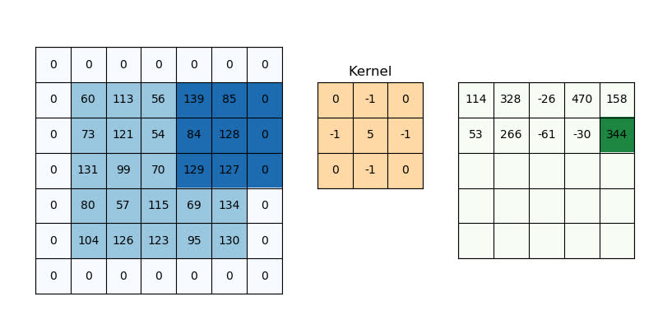
Zero Padding

Slide 22
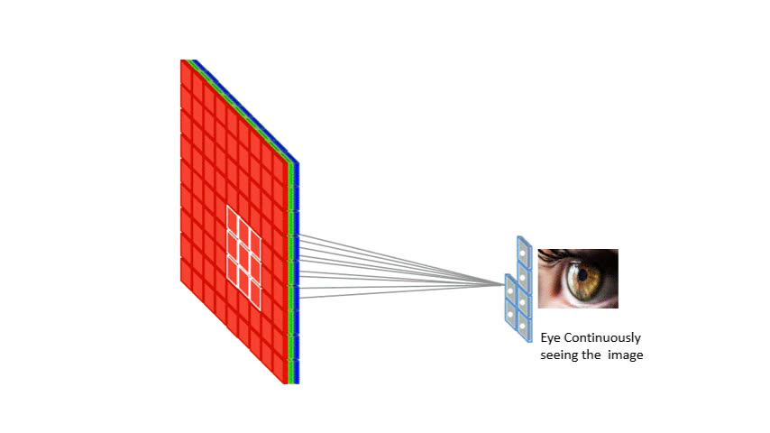
Pooling
Simplifying Complex Data:
Pooling is like summarizing information,
keeping what's important.
Dimensionality Reduction:
It helps reduce the dimensionality
while retaining essential information.
Pooling = Downsizing + Information Summary

Slide 23
Analogies to Understand Pooling
Image Compression Analogy
Pooling is like compressing an image file. You lose some details, but the essential features are still there.
Teacher Analogy
Imagine a teacher summarizing a chapter. They highlight the key points (max pooling) or give an overall summary (average pooling), making it easier for students to remember the main ideas.

Slide 24
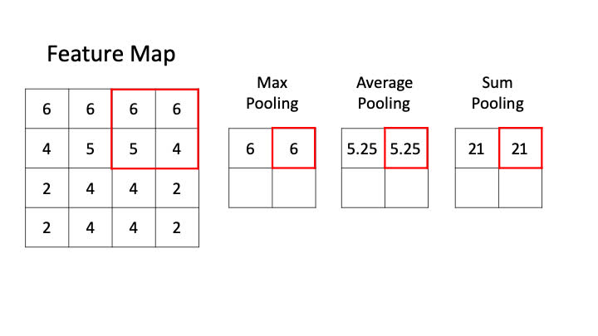
Types of Pooling

Slide 25
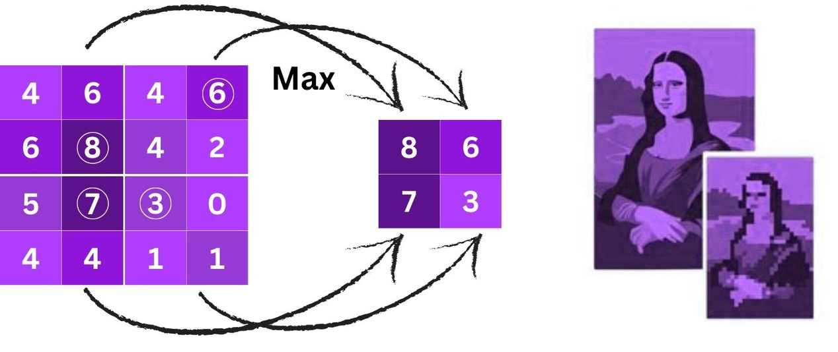
Types of Pooling
Max Pooling:
Selects the maximum value from a
set of values. Think of it as choosing
the most important feature.

Slide 26
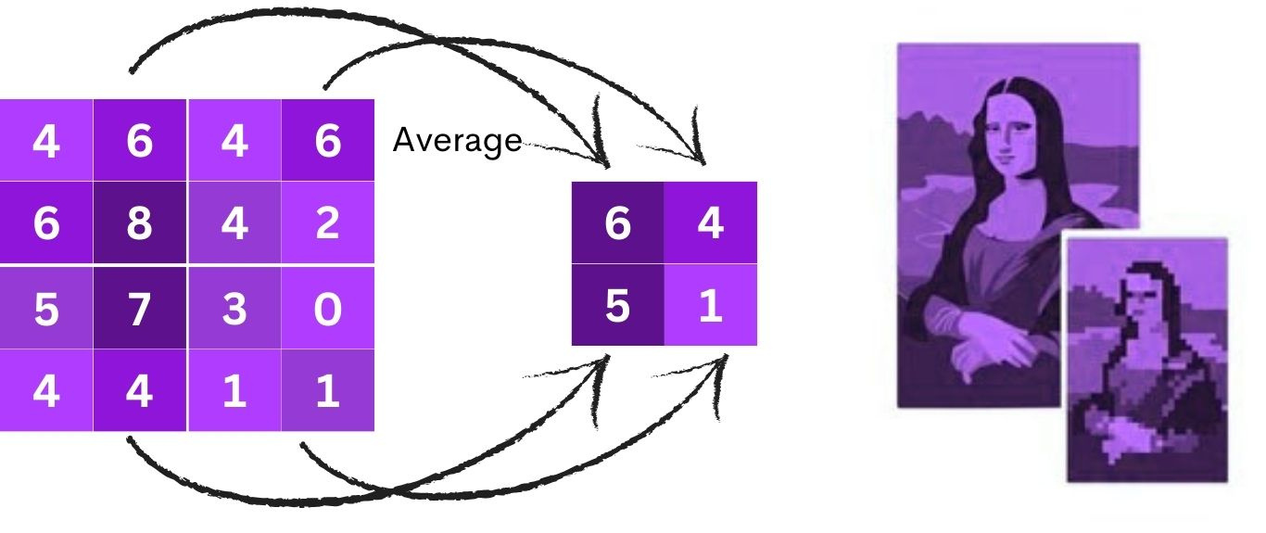
Types of Pooling
Average Pooling:
Computes the average of a set of values.
It smooths out the representation.

Slide 27
Advantages of Max Pooling
Feature Retention:
Keeps dominant features intact.
Translation Invariance:
Recognizes features regardless of exact location.
Dimension Reduction:
Reduces data size, providing efficiency.

Slide 28
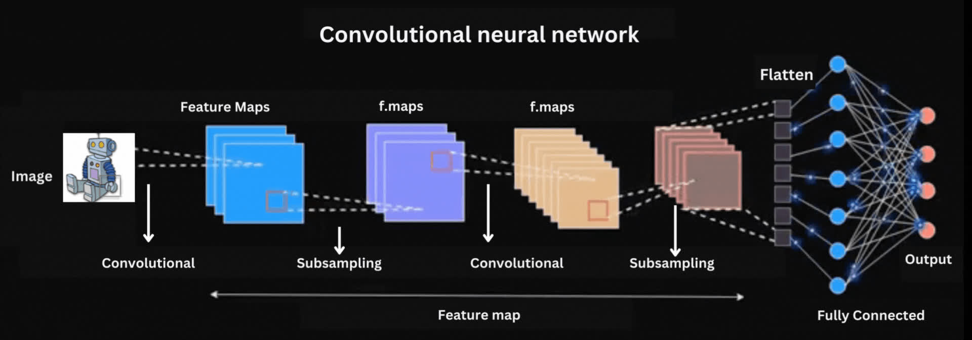
Convolutional Neural Network (CNN) Architecture
CNNs are a type of Neural Networks
inspired by how our brain processes
visual information.
They're specialized for understanding
images, making them powerful tools in
image analysis, recognition, and more.

Slide 29
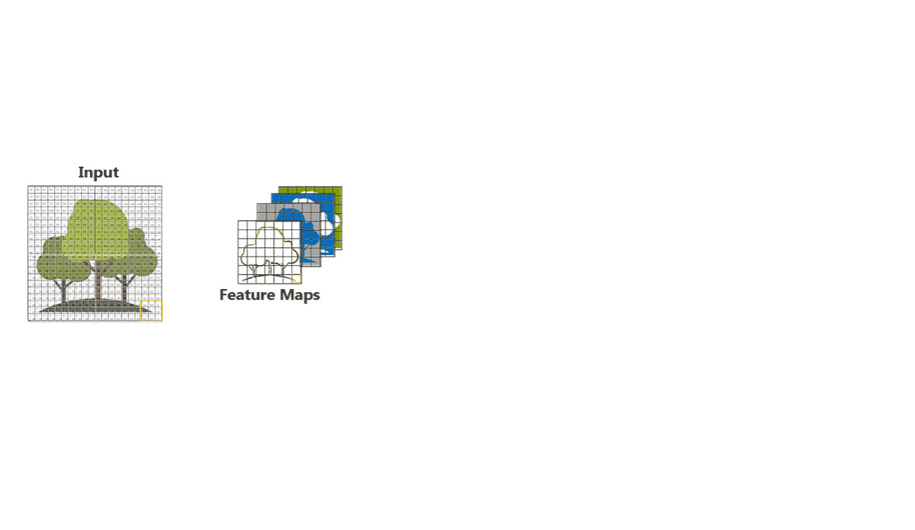
CNN Architecture

Slide 30
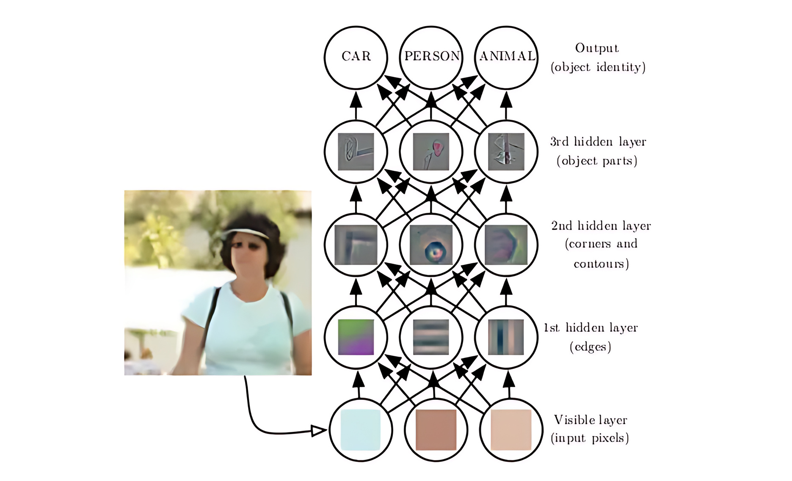
Object Recognition Process at a Glance from Pixel to Detection

Slide 31


Home Work
Practice the given code using different hyperparameters (epochs, learning rate and batch size) and different numbers of Layers

